Slide 1
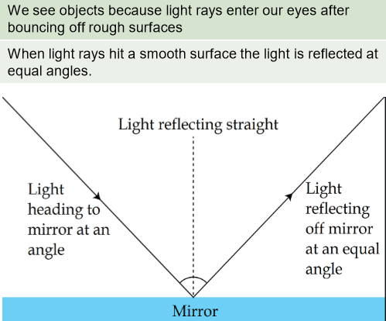
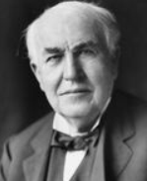
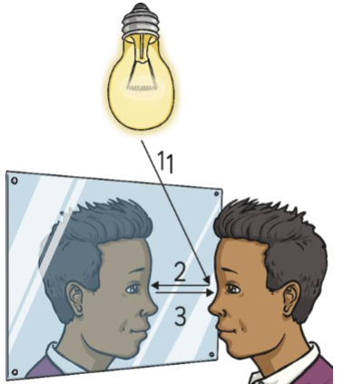
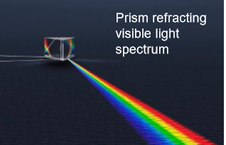
Hollingworth Primary School Knowledge Organiser
Topic: Light
Year: 6
Strand: Physics
Famous scientist
Reflection of light
Key Vocabulary
light | Light is a type of energy that makes it possible for us to see the world around us.
Source of light | The Sun and other stars, fires, torches and lamps all make their own light and so are examples of sources of light.
Reflection | Reflection occurs when a light ray hits a surface and bounces off.
Refraction | Refraction is the bending of light as it passes from one substance to another.
Shadow | A dark area or a shape produced by an object coming between rays of light and a surface.
Opaque | An opaque material does not let light through. It does not reflect light.
Translucent | A translucent material lets light pass through, but objects on the other side can't be seen clearly.
Transparent | Transparent materials allow you to see clearly through them.
Prism | A prism is a three-dimensional shape with identical ends. A prism allows us to see the visible spectrum
 | .
Thomas Edison
(February 11, 1847 – October 18, 1931).
He was an American inventor and entrepreneur, who invented many things. Edison developed one of the first practical light bulbs, but contrary to popular belief did not invent the light bulb.
In 1879, Edison made a light bulb
that lasted longer than others.
Another invention, the electric
power distribution network, lasted
even longer.
What should I already know?
How we see things
• Recognise that they need light in order to see things and that dark is the absence of light.
• Notice that light is reflected from surfaces.
• Recognise that light from the sun can be dangerous and that there are ways to protect their eyes.
• Recognise that shadows are formed when the light from
a light source is blocked by an opaque object.
• Compare and group together everyday materials on the basis of their properties, including their hardness, solubility, transparency, conductivity (electrical and thermal), and response to magnets.)

Slide 2
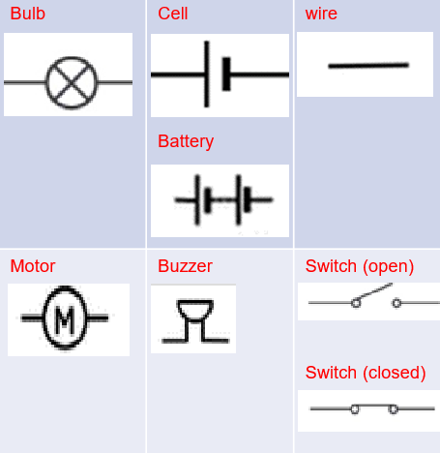
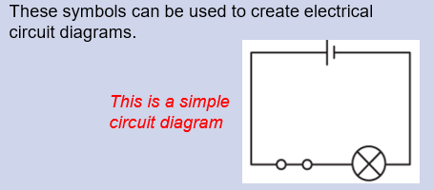
Hollingworth Primary School Knowledge Organiser
Topic: Electricity
Year: 6
Strand: Physics
Famous scientist
Components of a circuit and their symbols
Key Vocabulary
circuit | A complete path that an electric current can flow around.
symbol | A visual picture that stands for something.
Circuit diagram | A visual representation of an electrical circuit using symbols to represent the electrical components.
Cell/ battery | A device that stores energy as a chemical until it is needed. A cell is a single unit. A battery is a collection of cells
Switch | An electrical component that can make or break an electrical circuit.
Voltage | The force that makes electricity move through a wire.
Bulb | A glass bulb which provides light by passing an electrical current through a filament.
Buzzer | An electrical device that makes a buzzing noise and is used for signalling (for example, in a burglar alarm).
Current | A flow of electricity, measured in amps.
Motor | A machine that produces motion or power for doing work.
Hedi Lamar
What should I already know?
• Identify common appliances that run on electricity.
• Construct a simple series electrical circuit, identifying and naming its basic parts, including cells, wires, bulbs, switches and buzzers.
• Identify whether or not a lamp will light in a simple series circuit, based on whether or not the lamp is part of a complete loop with a battery.
• Recognise that a switch opens and closes a circuit and associate this with whether or not a lamp lights in a simple series circuit.
• Recognise some common conductors and insulators, and associate metals with being good conductors.
Simple circuit diagram

Slide 3
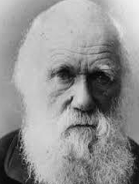
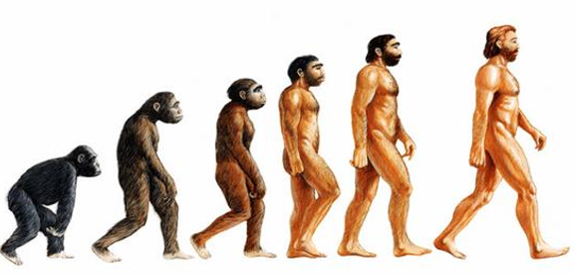
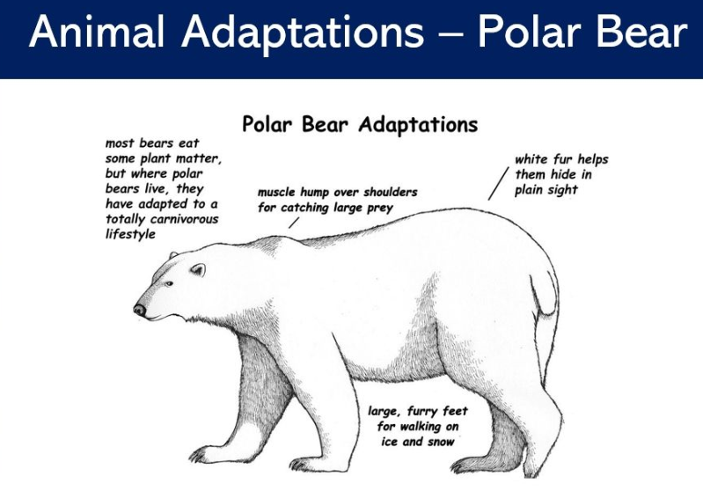
Hollingworth Primary School Knowledge Organiser
Topic: Evolution and Inheritance
Year: 6
Strand: Biology
Famous scientist
Evolution
Key Vocabulary
off-spring | When living things reproduce they pass on characteristics to their offspring. All living things produce offspring of the same kind, but normally offspring are not identical to their parents.
adaptation | Adaptation is the process by which animals, plants and other living things have changed so that they better suit their habitat.
evolution | Evolution is the theory that all the kinds of living things that exist today developed from earlier types.
inheritance | When living things reproduce they pass on characteristics to their offspring. This is known as inheritance.
Genes | Genes that are passed on to you determine many of your traits, such as your hair colour and skin colour .
Selective breeding | Selective breeding is the process by which humans control the breeding of organisms in order to exhibit or eliminate a particular characteristic.
Natural selection | The process where organisms better adapted to their environment tend to survive and produce more offspring. It is now regarded as the main process that brings about evolution
Characteristics | A feature or quality belonging typically to a person, place, or thing and serving to identify them.
Charles Darwin (1809 – 1882) was an expert in natural history. He went on a famous sea voyage in 1831 on a ship called HMS Beagle and visited many places around the world, collecting animal and plant samples. The observations he made led him to his theory of evolution.
He came up with the idea that animals evolve due to
having the characteristics that make them best suited to
their environment. He called this 'The survival of the
fittest’ or ‘natural selection’.
What should I already know?
Adaptation
• Identify that most living things live in habitats to which they are suited and describe how different habitats provide for the basic needs of different kinds of animals and plants, and how they depend on each other.
• Notice that animals, including humans, have offspring which grow into adults.
• Explore the part that flowers play in the life cycle of flowering plants, including pollination, seed formation and seed dispersal.
• Describe in simple terms how fossils are formed when things that have lived are trapped within rock.

Slide 4
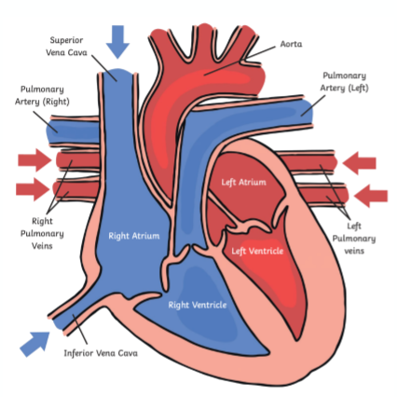
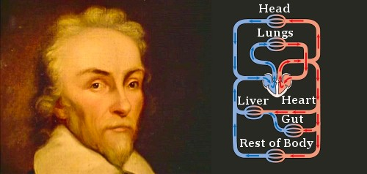
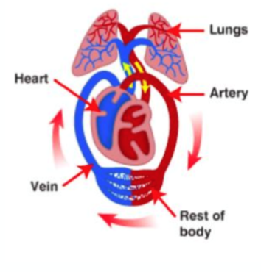
Hollingworth Primary School Knowledge Organiser
Topic: Animals Including Humans
Year: 6
Strand: Biology
Famous scientist
The Heart
Key Vocabulary
Circulatory System | An organ system that allows blood to circulate and transport nutrients, oxygen, carbon dioxide around the body.
heart | A muscular organ that pumps the blood through the circulatory system.
Blood vessels | Tubular structures carrying blood through the tissues and organs; a vein, artery, or capillary.
blood | The red liquid that circulates in the arteries and veins of humans and other vertebrate animals, carrying oxygen to and carbon dioxide from the tissues of the body.
arteries | Any of the muscular-walled tubes forming part of the circulation system by which oxygenated blood is taken from the heart to all parts of the body.
veins | Vessels that carry deoxygenated blood towards the heart.
capillaries | Tiny blood vessels connecting arteries to veins.
Lungs | The two spongy organs inside your chest that fill with air when you breathe.
William Harvey was born on April 1, 1578 in Folkstone, England. He was born into a relatively wealthy family: his father, Thomas Harvey, was a successful businessman who became Mayor of Folkstone; his mother, Joane Hawke, gave birth to nine children, of whom William was the eldest. William Harvey was the first person to correctly describe blood’s circulation in the body. He showed that arteries
and veins form a complete circuit. The circuit starts at
the heart and
leads back to the heart.
What should I already know?
The Circulatory System
• Describe the importance for humans of exercise, eating the right amounts of different types of food, and hygiene.
• Identify that animals, including humans, need the right types and amount of nutrition, and that they cannot make their own food; they get nutrition from what they eat.
• Describe the simple functions of the basic parts of the digestive system in humans.
• Identify the different types of teeth in humans and their simple functions.

Slide 5
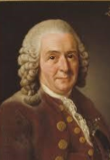
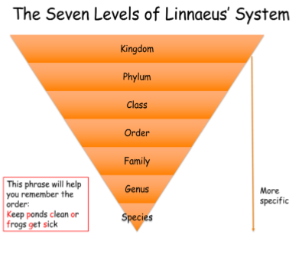
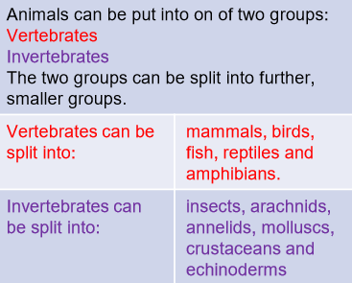
Hollingworth Primary School Knowledge Organiser
Topic: Living Things and their Habitat
Year: 6
Strand: Biology
Famous scientist
Classification
Key Vocabulary
Micro- organisms | A living thing too small to been seen by the human eye.
invertebrate | Animals without a backbone.
vertebrate | Animals with a backbone or spinal column.
insect | A small arthropod animal that has six legs and three body parts.
molluscs | Invertebrate with an unsegmented body that can have a hard shell.
arachnid | A small invertebrate usually with eight legs.
bacteria | A single celled organism that can live anywhere.
species | A group of living things that are closely related.
Carl Linnaeus was a Swedish scientist who believed it was very important to have a standard system of classification.
At the time he was alive, in the 1700s, there was no agreed standard method.
In 1735, he published his first edition of ‘Systema Naturae’, which described his system for classifying living things. Linnaeus' original system of classification classified everything in nature into a hierarchy.
What should I already know?
Grouping Living Things
• Recognise that living things can be grouped in a variety of ways.
• Explore and use classification keys to help group, identify and name a variety of living things in their local and wider environment.
• Describe the differences in the life cycles of a mammal, an amphibian, an insect and a bird.
• Describe the life process of reproduction in some plants and animals.

